Slide 1

Emotion Recognition with NLP
Dániel Elek, Yuliia Bobrovytska, Max Meiners

Slide 2
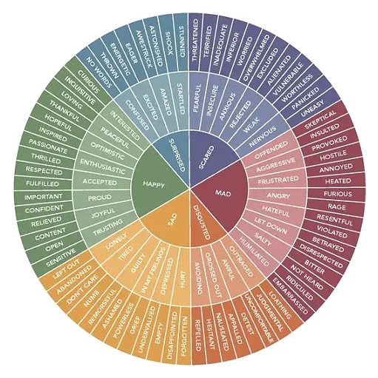

The Project
Banijay Benelux
Survivor (“Expeditie Robinson”)
Paul Ekman’s six core emotions

Slide 3

The datasets used
GoEmotions
SMILE Twitter Emotion
Friends emotion labeled dialogue
MELD
CARER
Affective Text
Daily Dialogue
Affect data
Emotion Dataset for Emotion Recognition Tasks (Kaggle)
OpenAI API

Slide 4
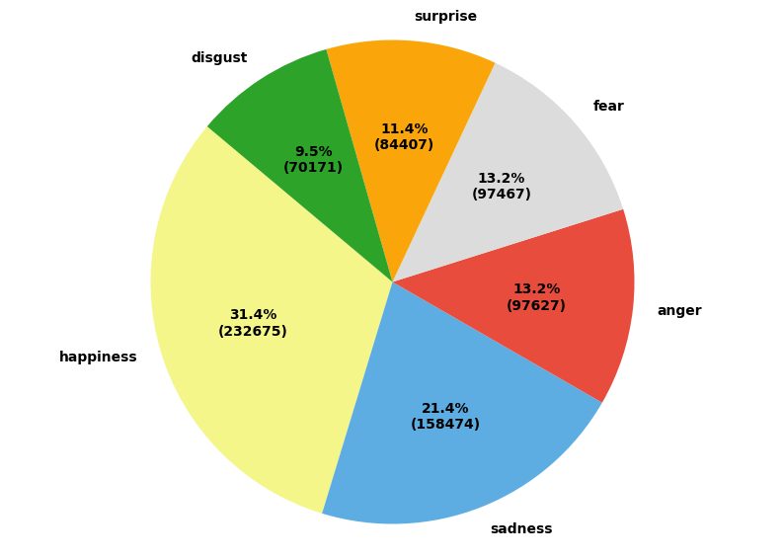
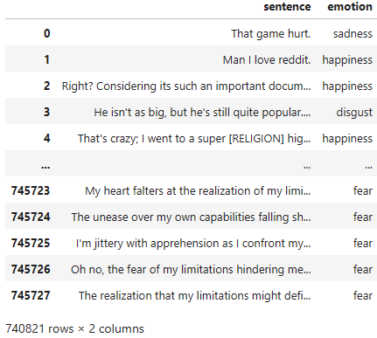
Final dataset
Only the sentences as features
Composition:
Happiness: 232675
Sadness: 158474
Anger: 97627
Fear: 97467
Surprise: 84407
Disgust: 70171

Slide 5
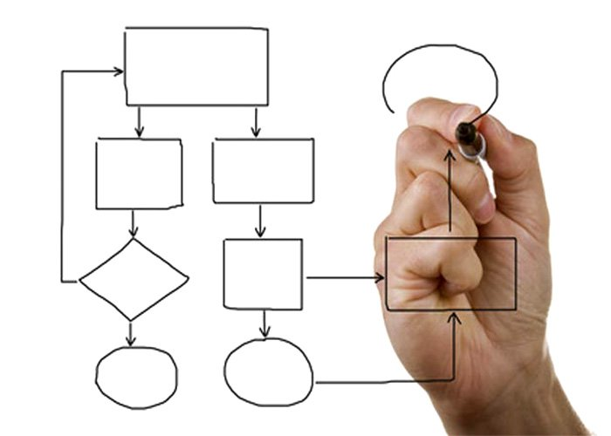
Methodology
Data collection and preprocessing
Merging and augmenting the data
Feature extraction
Model selection and training
Hyperparameter tuning

Slide 6

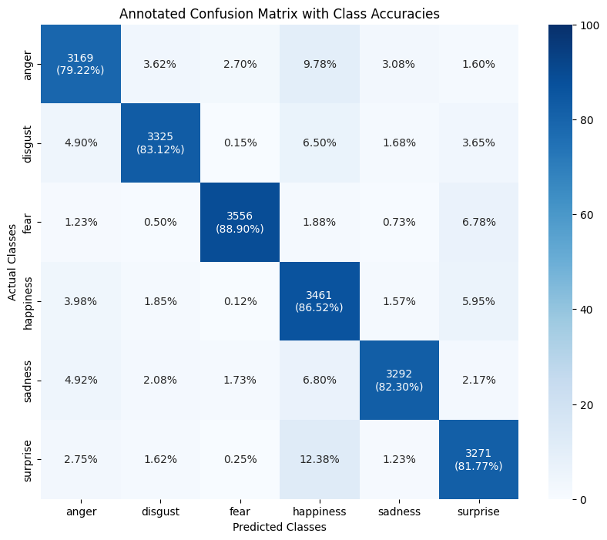
Road to the best performing model
Batch size: 256
Learning Rate: LR scheduler
Epochs: 20 (Early stopping)
Test size: 0.2
Max length: 128
Weighted F1: 0.84

Slide 7
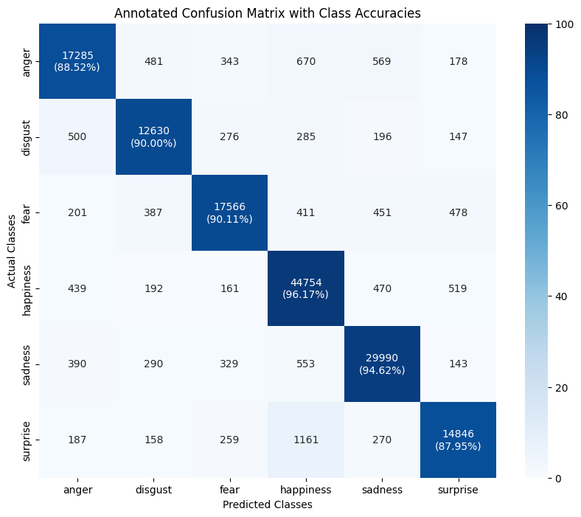
Road to the best performing model
Batch size: 128
Learning Rate: 0.00001 (1e-5)
Epochs: 100 (Early stopping)
Test size: 0.2
Max length: 128
Weighted F1: 0.92

Slide 8
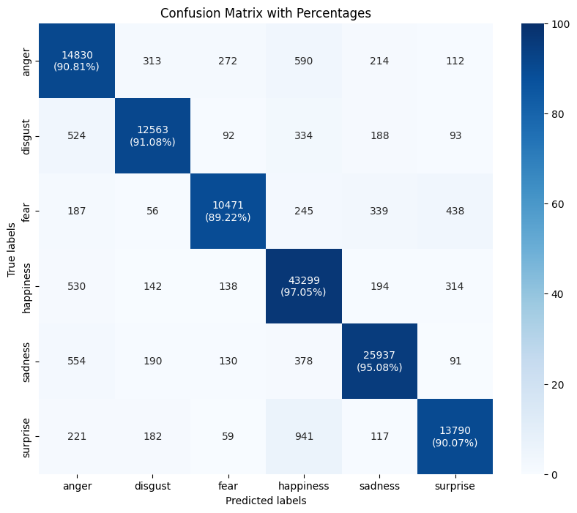
Road to the best performing model
Batch size: 128
Learning Rate: 0.00002 (2e-5)
Epochs: 100 (Early stopping)
Test size: 0.2
Max length: 128
Weighted F1: 0.94
Batch size: 256
Learning Rate: LR scheduler
Epochs: 20 (Early stopping)
Test size: 0.2
Max length: 128
Weighted F1: 0.84
Batch size: 128
Learning Rate: 0.00001 (1e-5)
Epochs: 100 (Early stopping)
Test size: 0.2
Max length: 128
Weighted F1: 0.92
Batch size: 128
Learning Rate: 0.00002 (2e-5)
Epochs: 100 (Early stopping)
Test size: 0.2
Max length: 128
Weighted F1: 0.94

Slide 9
Road to the best performing model
Batch size: 256
Learning Rate: LR scheduler
Epochs: 20 (Early stopping)
Test size: 0.2
Max length: 128
Weighted F1: 0.84
Batch size: 128
Learning Rate: 0.00001 (1e-5)
Epochs: 100 (Early stopping)
Test size: 0.2
Max length: 128
Weighted F1: 0.92
Batch size: 128
Learning Rate: 0.00002 (2e-5)
Epochs: 100 (Early stopping)
Test size: 0.2
Max length: 128
Weighted F1: 0.94

Slide 10
Error analysis

Slide 11
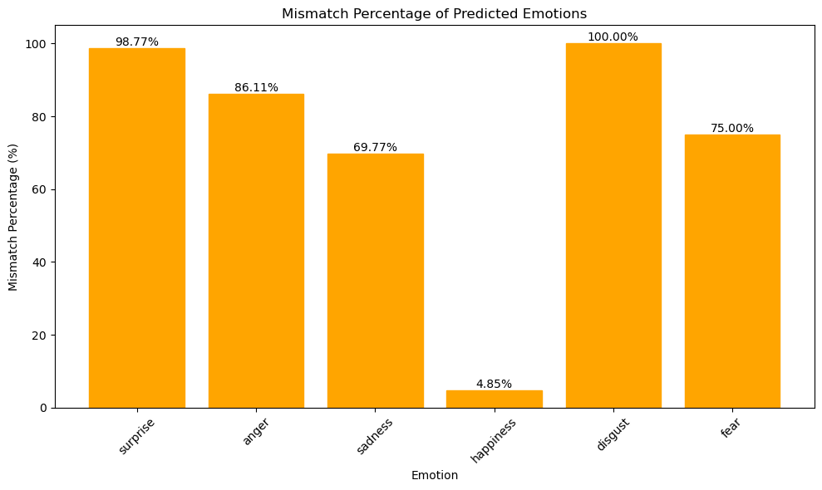
The Robinson dataset
166 wrong predictions from 442 – 38%
Surprise: 80
Anger: 31
Sadness: 30
Happiness: 13
Disgust: 6
Fear: 6

Slide 12
What could cause this?

Slide 13
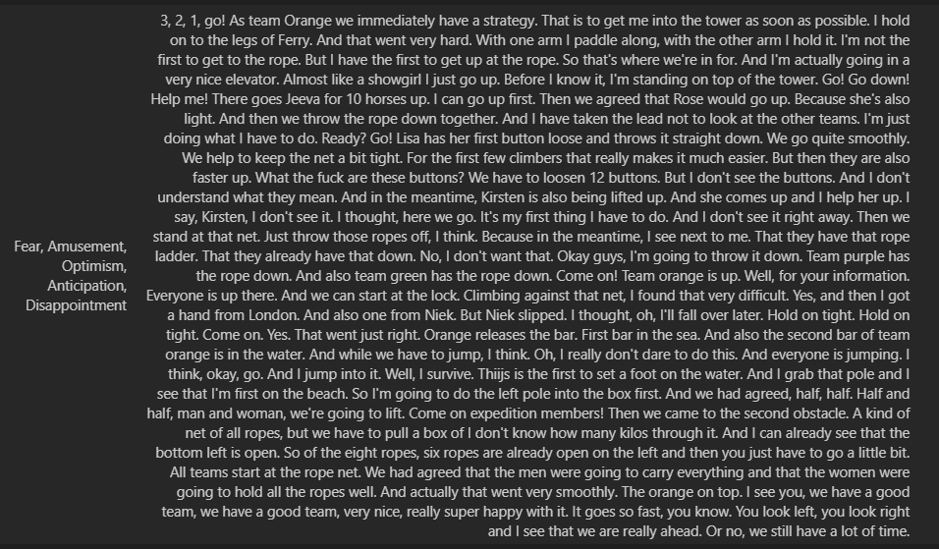
Unusual labeling

Slide 14
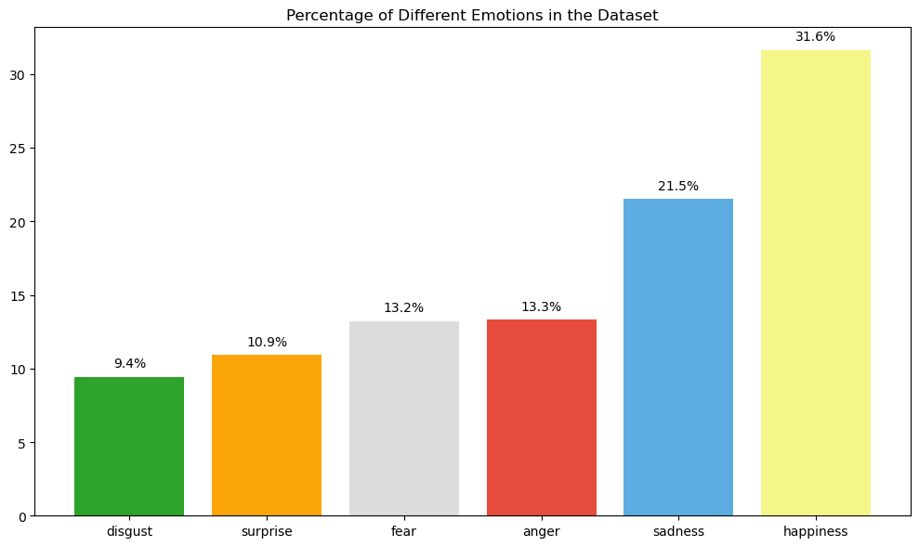
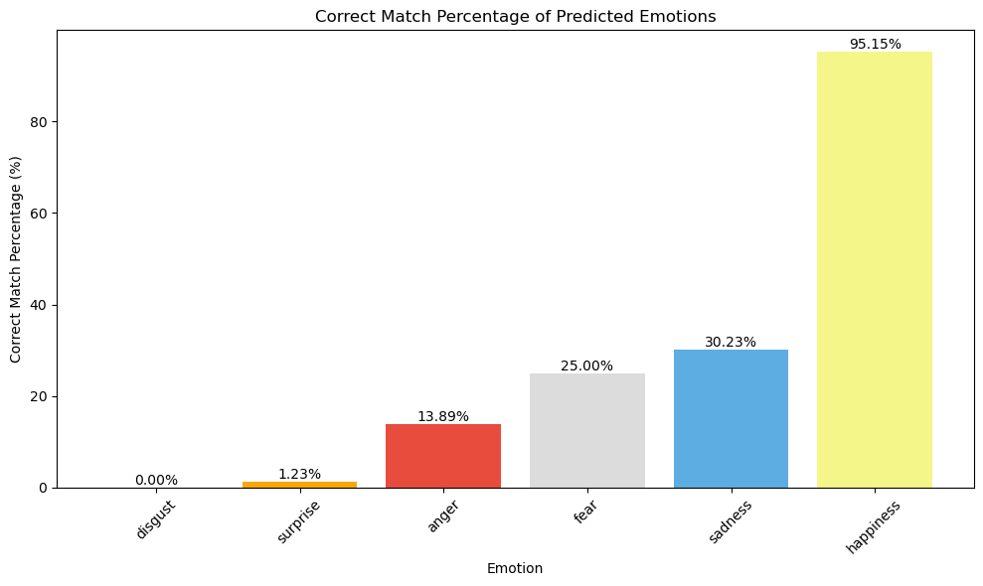
Error analysis
The order of the prevalence of emotions and correctly predicted labels match almost perfectly

Slide 15
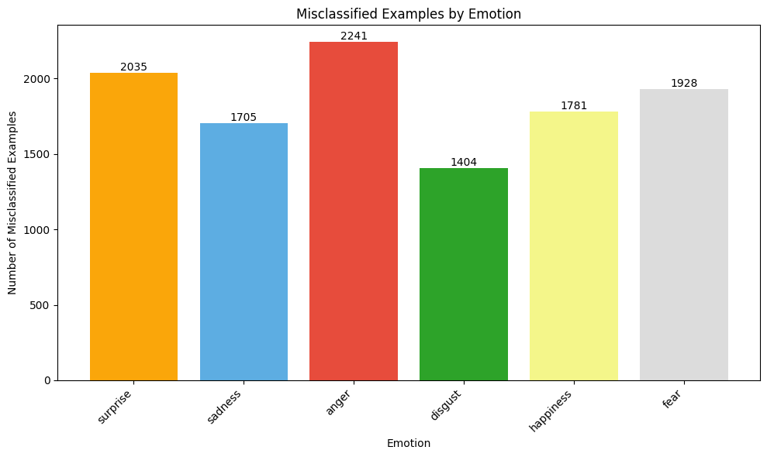
Misclassified sentences in our local test set

Slide 16

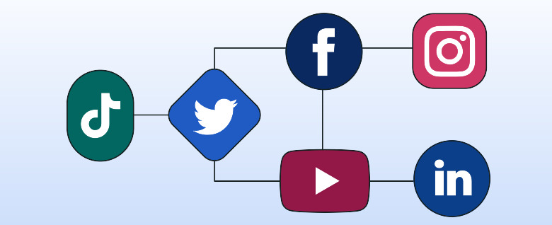
Application
Social media monitoring
Market research
NPC interaction enhancement
Content recommendation based on emotional state
Political campaign analysis

Slide 17

Conclusion
Robust model, just not for this type of data
A different approach could be tried

Slide 18
Reference
https://adsai.buas.nl/Year2/BlockC/

